Slide 1


ncca RenderFarm Tool
Maya: Arnold
Constantinos Glynos
Michail Agoulas

Slide 2
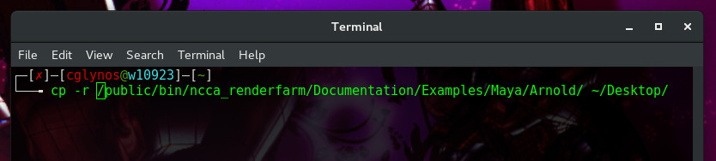
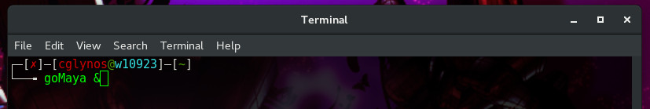
Copy the example scene
run the copy (cp) command with the recursive flag (-r)
cp –r /public/bin/ncca_renderfarm/Documentation/Examples/Maya/Arnold/ ~/Desktop
Open Maya
goMaya &

Slide 3
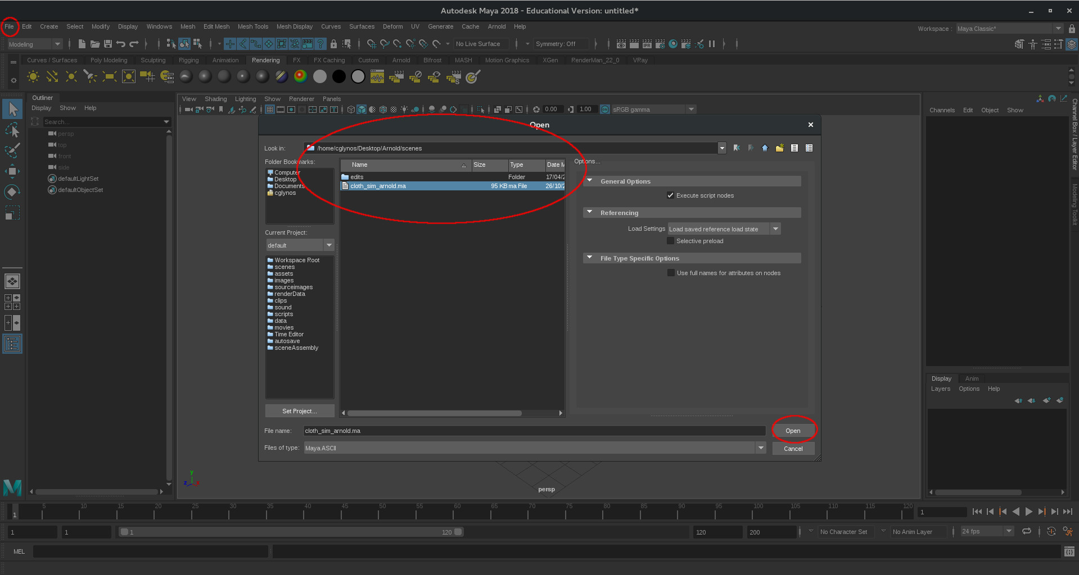
Open the example scene
File -> Open -> cloth_sim_arnold.ma

Slide 4
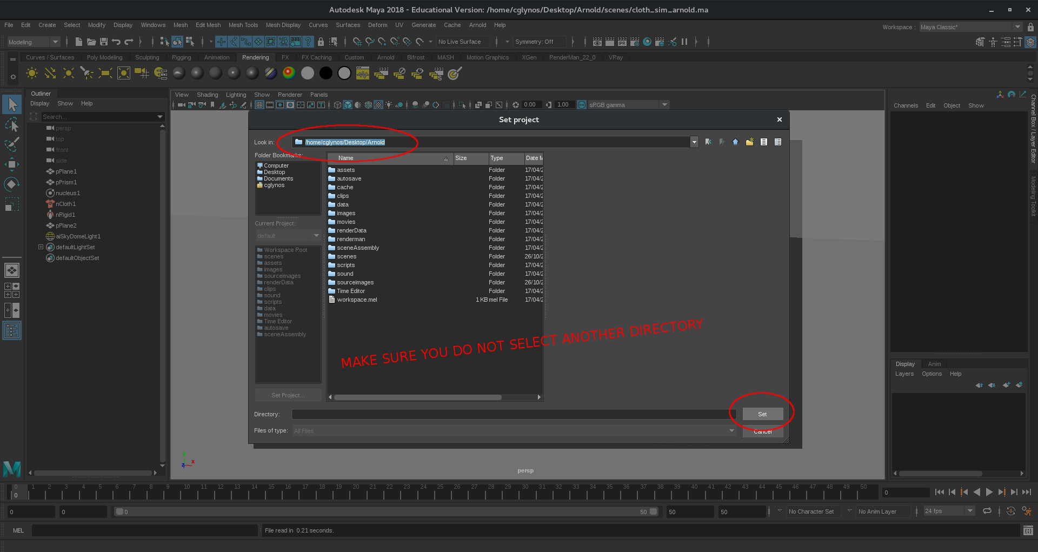
Set project directory
File -> Set Project...
Select the directory which is parent to all the project data files and folders.
Make sure you do not select another directory inside the parent directory
Click Set

Slide 5
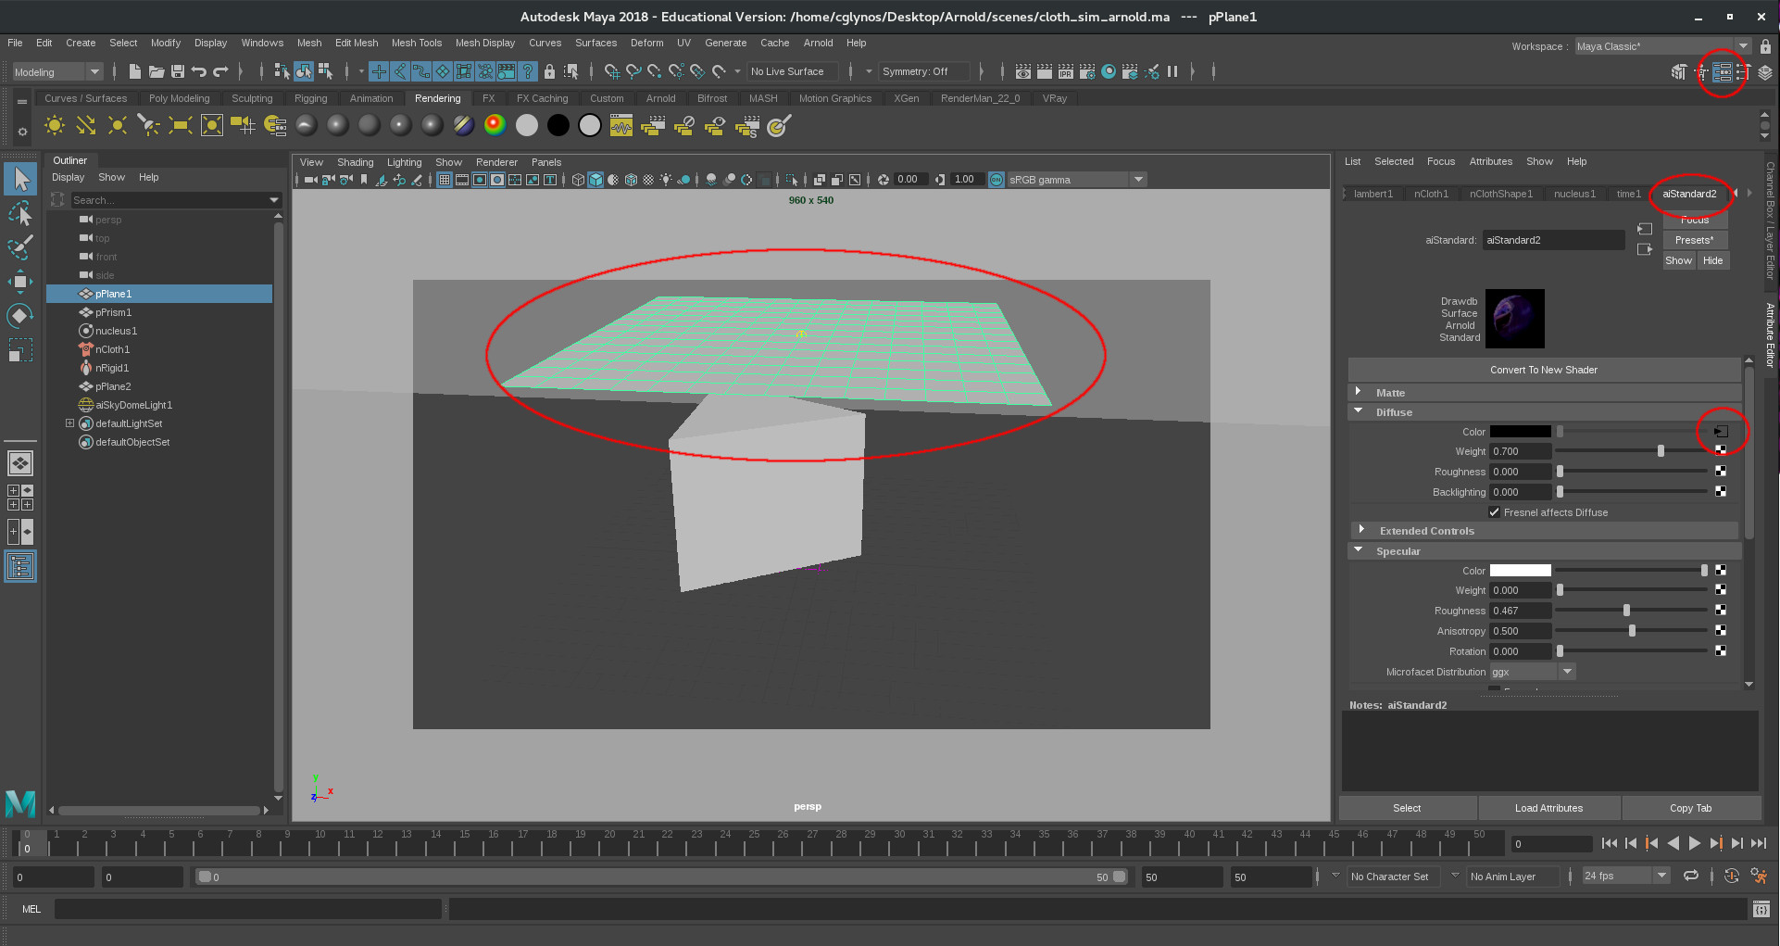
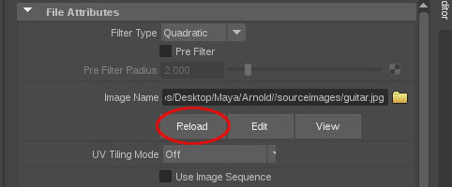
Update the textures
Select the pPlane1 mesh
Go to the Attribute Editor -> aiStandard2
Click on the Diffuse colour option box
Under the Image Name text box, click on Reload.
After hitting Reload, that long path should now say:
sourceimages/guitar.jpg
Do the same for the rest of the objects if they have any textures

Slide 6
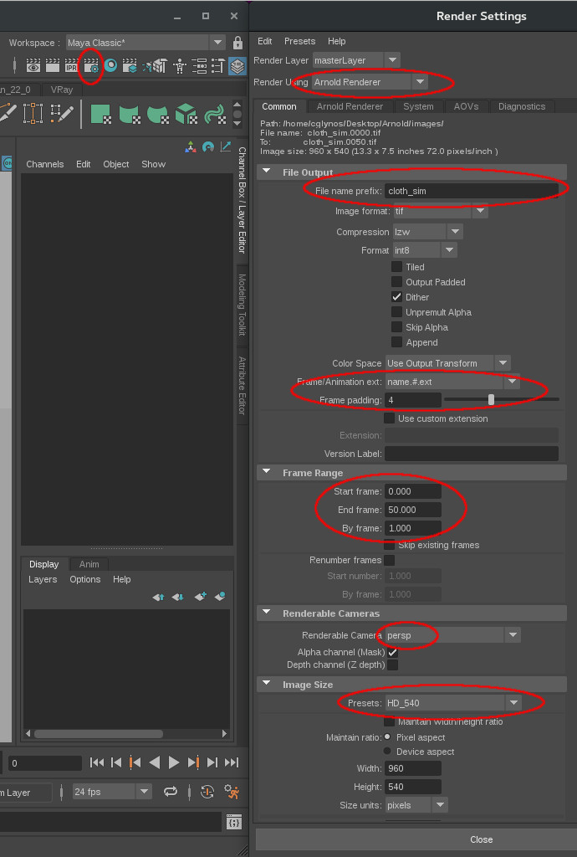
Check the render settings
Check that your render settings are correct:
Select the Arnold renderer
Make sure you have a name for the output renders
Check the format and frame padding
Make sure your animation frames are correct
Select the camera to render from
Set the correct resolution

Slide 7
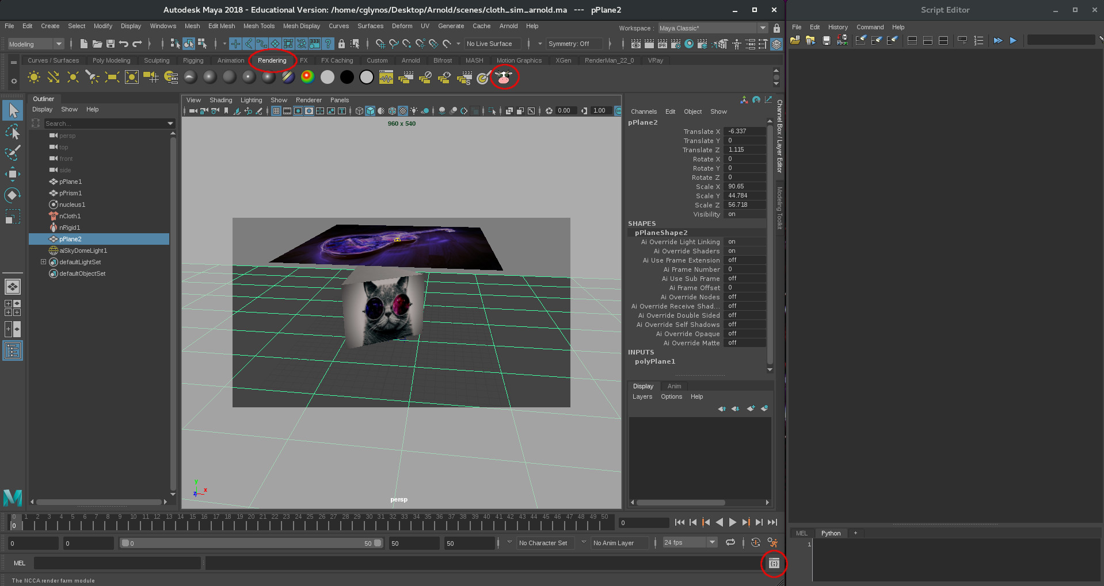
Let's render
Press Ctrl + S to save the scene
Open the Script Editor for debugging information
Go to the rendering shelf
Hit the cow!

Slide 8
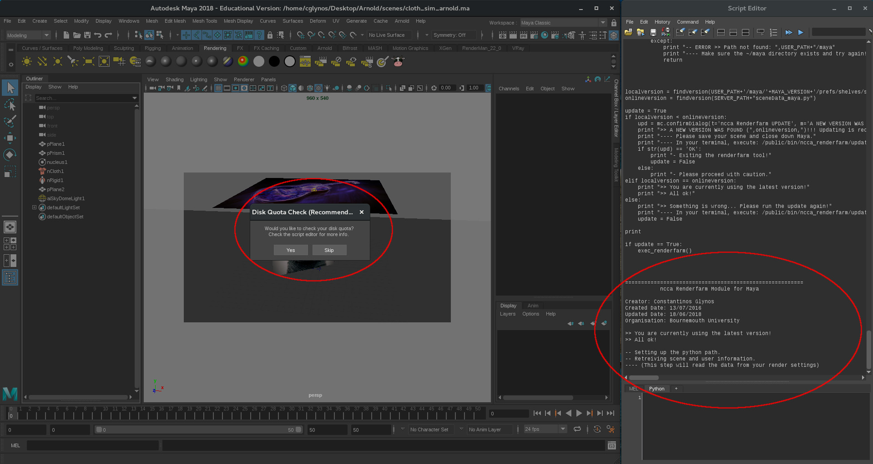
Using the tool
Check your local disk space (quota), or skip if not needed.
Check the script editor for any warnings about the version of the tool you are using.

Slide 9
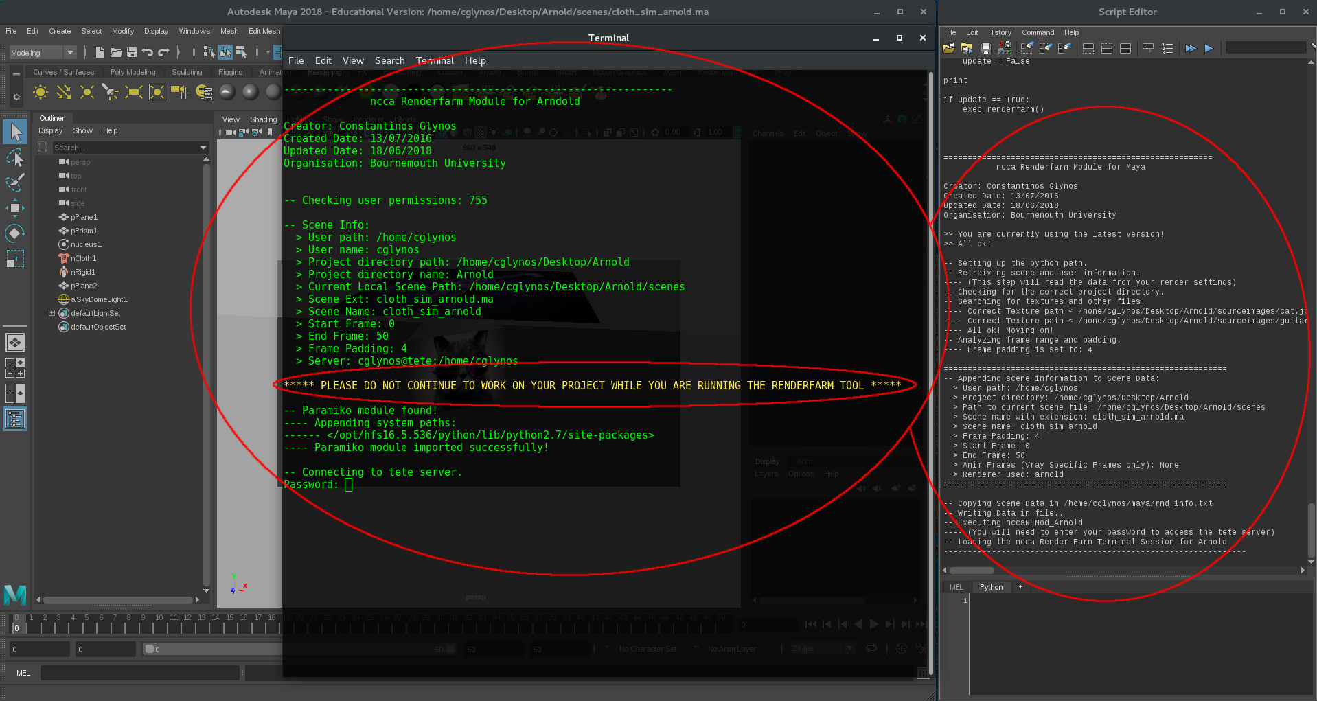
Using the tool
A new terminal will appear which links to the renderfarm.
Check the data passed on to the renderfarm by reading the script editor and the terminal. If not correct, just close the terminal to cancel the process.
DO NOT USE MAYA OR CONTINUE TO WORK ON YOUR SCENE WHILE YOU SUBMIT A JOB TO THE RENDERFARM.
Enter your password to continue.

Slide 10
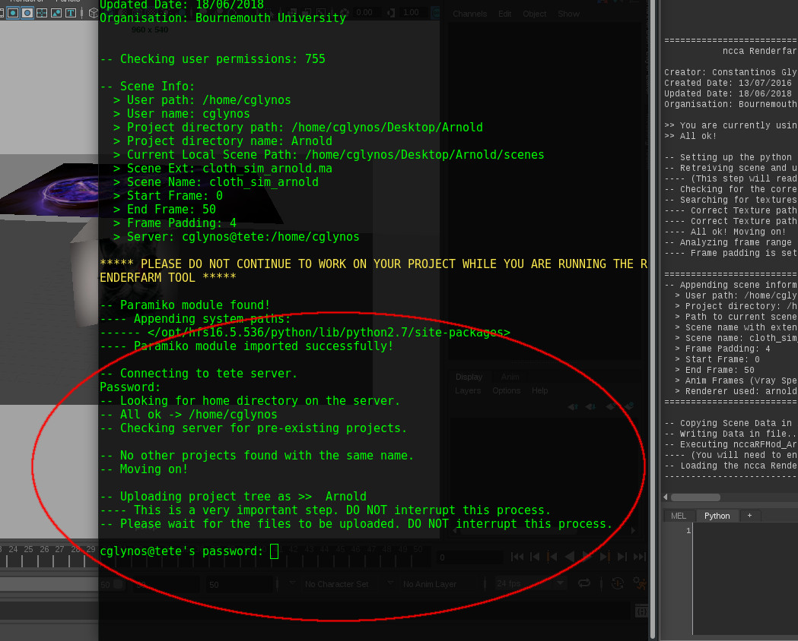
Using the tool
The tool will check if you have any existing directories with the same name on the server and prompt for action (replace or rename).
Enter your password again to upload your project directory onto the tete server.

Slide 11
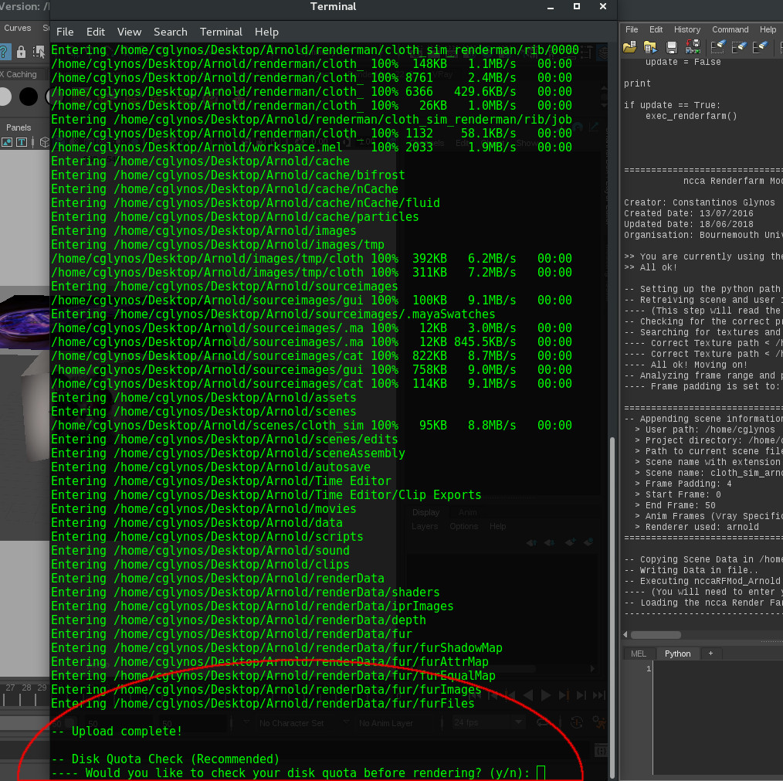
Using the tool
Once the files are uploaded, the tool will prompt for a quota check on the server.
If you do not have enough disk space (quota) available on the server, your renders will not be saved anywhere.
Skip online quota check iff you are sure you have enough space available.

Slide 12
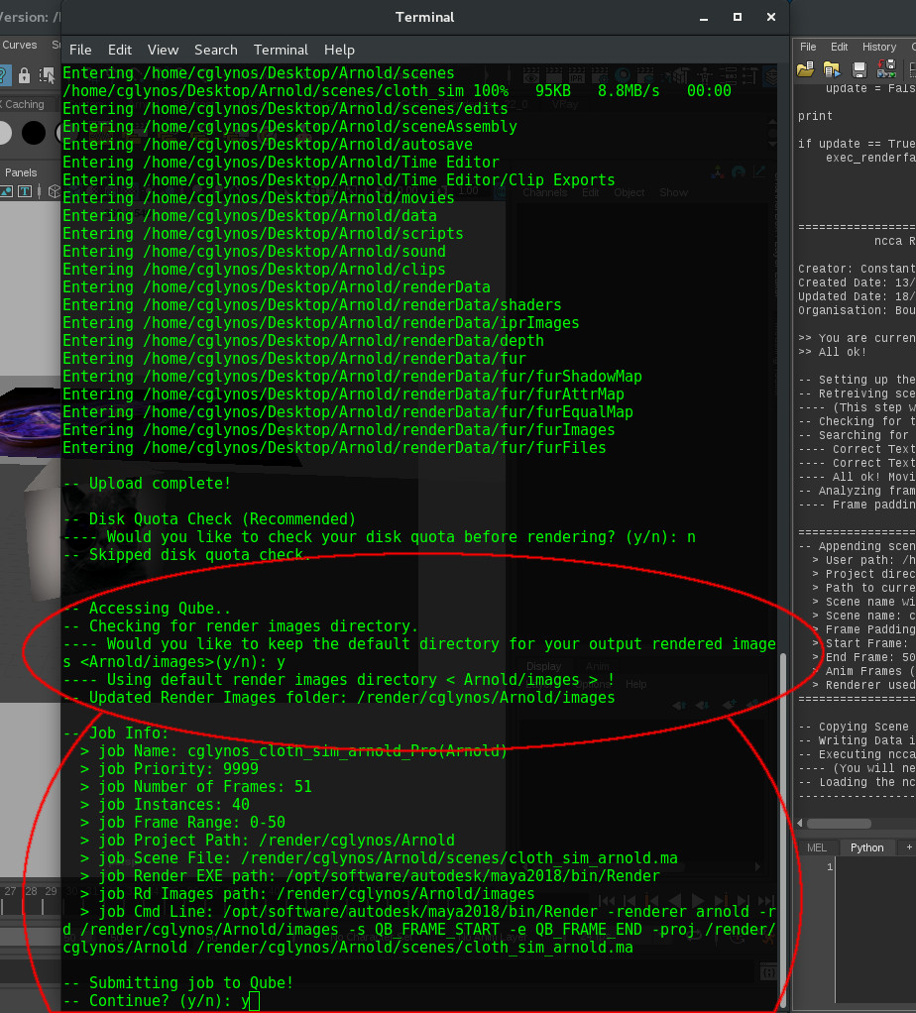
Using the tool
Set your output renders directory if you don't want to use the default one.
Check the Job info data before submitting the job to Qube.
Type y and Enter to continue.

Slide 13
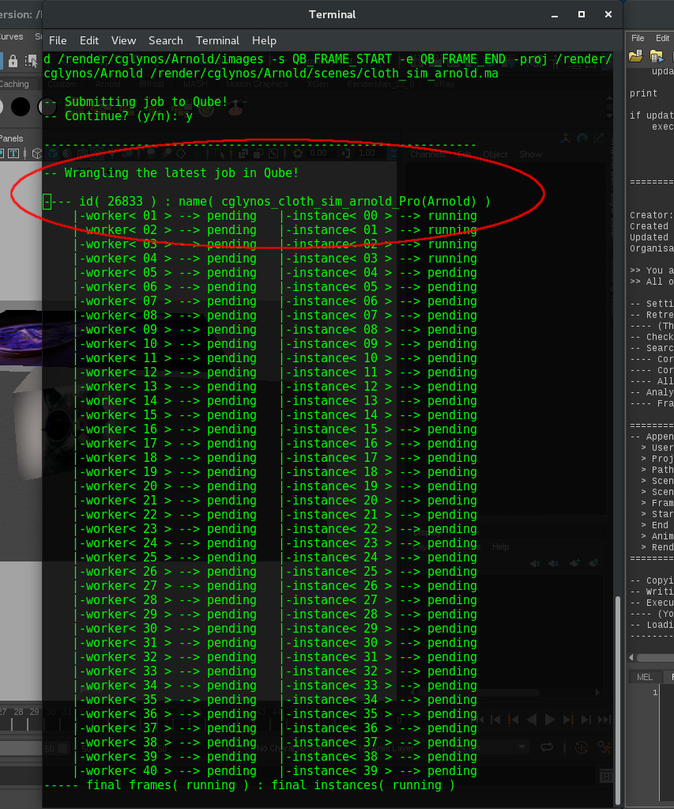
Using the tool
Wrangle your renders from the terminal.
At this point you can safely close the terminal and wrangle your renders from Qube. But it's advised that you leave the terminal open.
Now we wait for it to finish.
You can now continue to work on your scene.

Slide 14
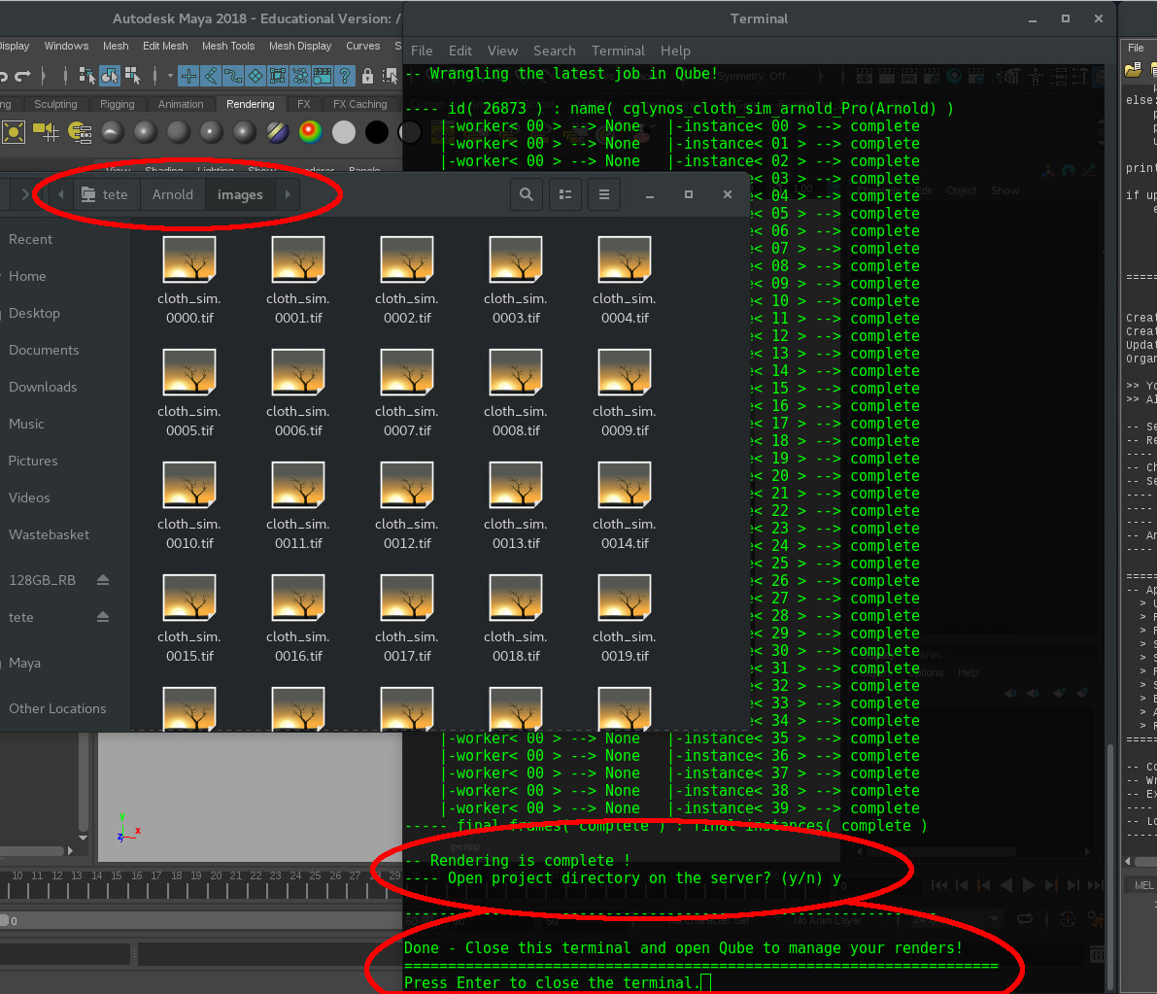
Finishing off
Once the renders are complete, the tool will prompt you to open the project directory on the server.
Type y and Enter so that the tool can open your project directory on the server. Otherwise, type n and Enter.
You can now close the terminal by pressing Enter again or by using the close button.

